Slide 1
COCOMO
COnstructive COst MOdel

Slide 2
COCOMO
The COstructive COst MOdel (COCOMO) is the most widely used software estimation model in the world.
The COCOMO model predicts the effort and duration of a project based on inputs relating to the size of the resulting systems and a number of "cost drives" that affect productivity.

Slide 3
COCOMO
As per Boehm, 1981 software development project can be classified into three categories based on development complexity:
Organic (Applications -> data processing programs)
A well-understood application program
Semidetached (Utilities -> compiler, linkers etc) and
Experienced and inexperienced staff
Embedded (System programs -> OS, real-time system programs)
Software, to be developed is strongly coupled with complex hardware
To classify a project one need to know
Characteristic of product, development team and development environment

Slide 4
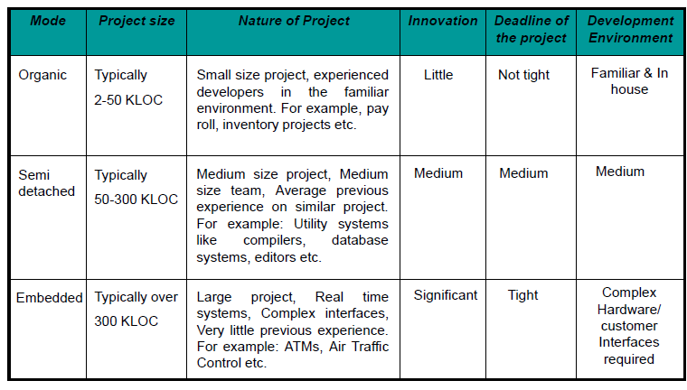

Slide 5
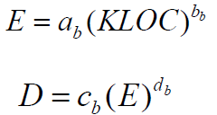
Basic Model
Basic COCOMO model takes the form
where E is effort applied in Person-Months, and D is the development time in months. The coefficients a_{b}, b_{b}, c_{b} and d_{b} are given in table on next slide.

Slide 6
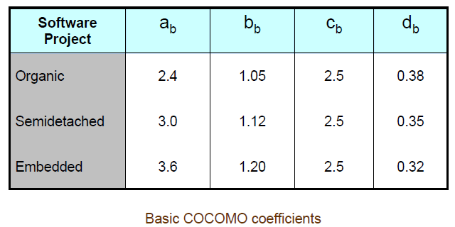

Slide 7
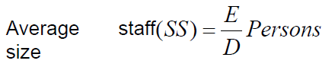

When effort and development time are known, the average staff size to complete the project may be calculated as:
When project size is known, the productivity level may be calculated as:

Slide 8
Example
Suppose that a project was estimated to be 400 KLOC. Calculate the effort and development time for each of the three modes i.e., organic, semidetached and embedded.

Slide 9
Solution
The basic COCOMO equation take the form:
E = a_{b} (KLOC)^{b}b
D = c_{b} (E)^{d}b
Estimated size of the project = 400 KLOC
(i) Organic mode
E = 2.4(400)^{1.05} = 1295.31 PM
D = 2.5(1295.31)^{0.38} = 38.07 PM
(ii) Semidetached mode
E = 3.0(400)^{1.12} = 2462.79 PM
D = 2.5(2462.79)^{0.35} = 38.45 PM
(iii) Embedded mode
E = 3.6(400)^{1.20} = 4772.81 PM
D = 2.5(4772.8)^{0.32} = 38 PM

Slide 10
Exercise
A project size of 200 KLOC is to be developed. Software development team has average experience on similar type of projects. The project schedule is not very tight. Calculate the effort, development time, average staff size and productivity of the project.

Slide 11
Solution
The semi-detached mode is the most appropriate mode; keeping in view the size, schedule and experience of the development team.
Hence, E = 3.0(200)^{1.12} = 1133.12 PM
D = 2.5(1133.12)^{0.35} = 29.3 PM
= 1133.12/29.3 = 38.67 persons

Slide 12
Productivity = KLOC/E = 200/1133.12 = 0.1768 KLOC/ PM
P =176 LOC / PM

Slide 13
Intermediate Model
According to COCOMO, the major productivity drivers include:
Product attributes: required reliability, database size, product complexity
Computer attributes: execution time constraints, storage constraints, virtual machine (VM) volatility, turnabout time
Personnel attributes: analyst capability, application experience, VM experience, programming language experience
Project attributes: modern programming practices, software tools, schedule constraints

Slide 14
Software Project Planning
Multipliers of different cost drivers
Cost Drivers | RATINGS
 | Very low | Low | Nominal | High | Very high | Extra high
Product Attributes
RELY
DATA
CPLX
Computer Attributes
TIME
STOR
VIRT
TURN
0.75
0.88
1.00
1.15
1.40
--
--
0.94
1.00
1.08
1.16
--
0.70
0.85
1.00
1.15
1.30
1.65
--
--
1.00
1.11
1.30
1.66
--
--
1.00
1.06
1.21
1.56
--
0.87
1.00
1.15
1.30
--
--
0.87
1.00
1.07
1.15
--

Slide 15
Software Project Planning
Cost Drivers | RATINGS
 | Very low | Low | Nominal | High | Very high | Extra high
Personnel Attributes
ACAP
AEXP
PCAP
VMEXP
LEXP
Project Attributes
MODP
TOOL
SCED
1.46
1.19
1.00
0.86
0.71
--
1.29
1.13
1.00
0.91
0.82
--
1.42
1.17
1.00
0.86
0.70
--
1.21
1.10
1.00
0.90
--
--
1.14
1.07
1.00
0.95
--
--
1.24
1.10
1.00
0.91
0.82
--
1.24
1.10
1.00
0.91
0.83
--
1.23
1.08
1.00
1.04
1.10
--
Multiplier values for effort calculations

Slide 16
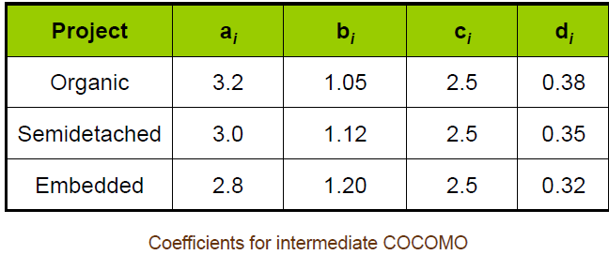
Intermediate COCOMO equations
EAF: effort adjustment factor

Slide 17
Example
A new project with estimated 400 KLOC embedded system has to be developed. Project manager has a choice of hiring from two pools of developers: Very highly capable (lot of application experience) with very little experience in the programming language being used
Or
Developers of low quality (very less application experience) but a lot of experience with the programming language.
What is the impact of hiring all developers from one or the other pool ?

Slide 18
Solution
This is the case of embedded mode and model is intermediate COCOMO.
Hence,
= 2.8(400)^{1.20} = 3712 PM
Case I: Developers are very highly capable with very little experience in the programming being used.
EAF = 0.82 x 1.14 = 0.9348
E = 3712 x .9348 = 3470 PM
D = 2.5 (3470)^{0.32} = 33.9 M

Slide 19
Case II: Developers are of low quality but lot of experience with the programming language being used.
EAF = 1.29 x 0.95 = 1.22
E = 3712 x 1.22 = 4528 PM
D = 2.5 (4528)^{0.32} = 36.9 M

